Slide 1
European Union vs. Eurasian Economic Union - two alternatives for Georgia?
Gaga Gabrichidze
New Vision University (Tbilisi, Georgia)

Slide 2
Economic attractiveness

Slide 3
EU – 388 716 (tsd. $)
CIS – 494 598 (tsd. $)
Others – 628 399 (tsd. $)
Source: Geostat

Slide 4
Source: Geostat

Slide 5
Perception

Slide 6
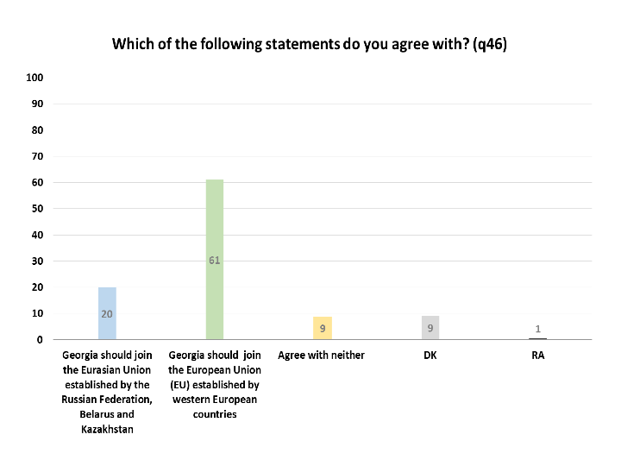
Source: NDI/CRRC public opinion survey, March, 2016

Slide 7
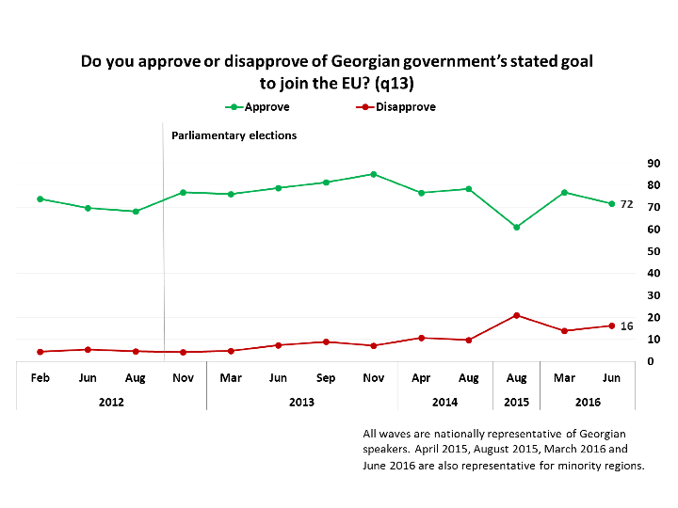
Source: NDI/CRRC public opinion survey, June, 2016

Slide 8
Proponents and opponents

Slide 10
Attractiveness (once again)

Slide 11
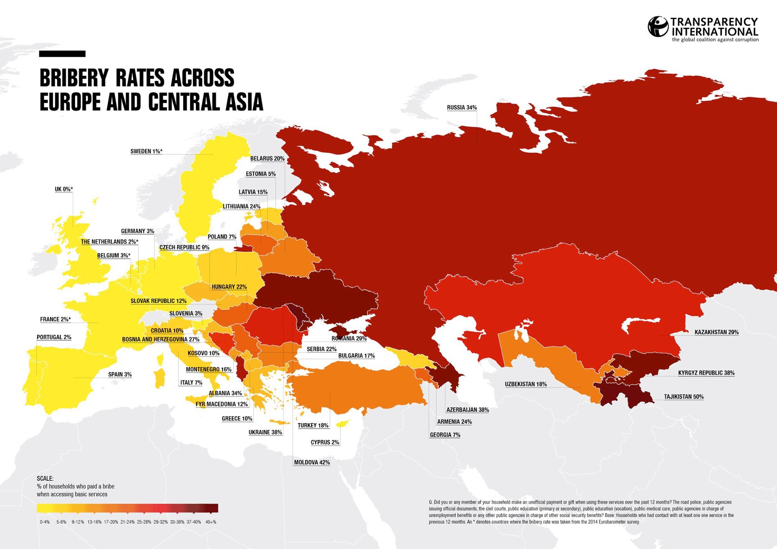
Source: Transparency International

Slide 12
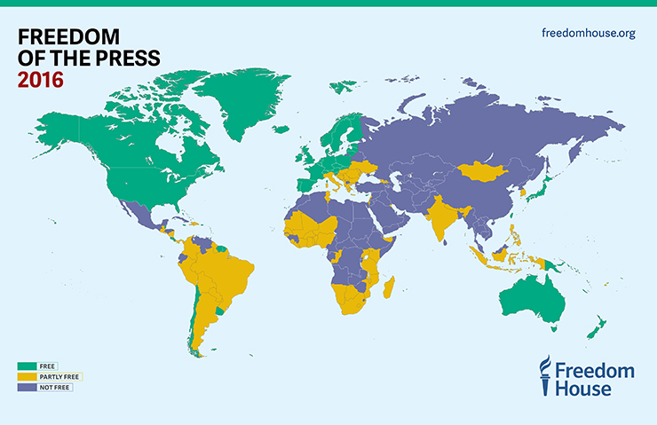
Source: Freedom House

